Slide 1


Introduction to C++.
Kusal Bista

Slide 2
Meet C++
C++ is a middle-level programming language.
Developed by Bjarne Stroustrup starting in 1979 at Bell Labs.
C++ runs on a variety of platforms, such as Windows, Mac OS, and the various versions of UNIX.

Slide 3
Why to Learn C++?
C++ is very close to hardware.
To understand about Object Oriented Programming.
C++ is one of the evergreen programming languages.
Most widely used programming languages in application and system programming.

Slide 4
Applications of C++ Programming
Application Software Development.
Programming Languages Development.
Computation Programming.
Games Development.
Embedded System.

Slide 5
Standard Libraries
The core language giving all the building blocks including variables, data types and literals, etc.
The C++ Standard Library giving a rich set of functions manipulating files, strings, etc.
The Standard Template Library (STL) giving a rich set of methods manipulating data structures, etc.

Slide 6
Semicolons in C++
In C++, the semicolon is a statement terminator.
x = y;
y = y + 1;
add(x, y);

Slide 7
Blocks in C++
A block is a set of logically connected statements that are surrounded by opening and closing braces.
{
cout << "Hello World";
// prints Hello World return 0;
}

Slide 8
C++ Identifiers
C++ variables must be identified with unique names.
These unique names are called identifiers.

Slide 9
General rules for constructing names for variables
Names can contain letters, digits and underscores.
Names must begin with a letter or an underscore (_).
Names are case sensitive (myVar and myvar are different variables).
Names cannot contain whitespaces or special characters like !, #, %, etc.
Reserved words (like C++ keywords, such as int) cannot be used as names

Slide 10
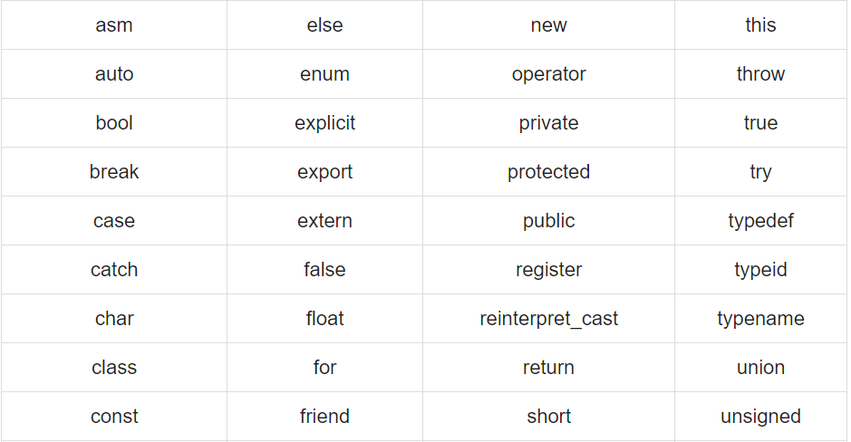
C++ Keywords

Slide 11
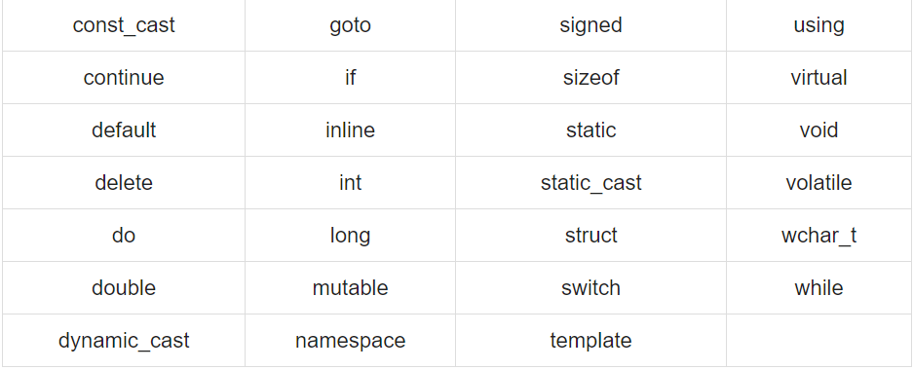
C++ Keywords

Slide 12
C++ Comments
Used to explain C++ code.
Makes code more readable.
Prevent execution when testing alternative code.
It can be singled-lined or multi-lined.

Slide 13

Single-line Comments
Single-line comments start with two forward slashes (//).
Any text between // and the end of the line is ignored by the compiler (will not be executed).

Slide 14
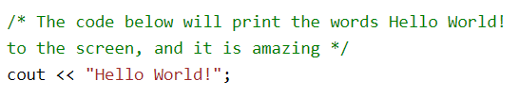
Multi-line comments
Multi-line comments start with /* and ends with */.
Any text between /* and */ will be ignored by the compiler:

Slide 15
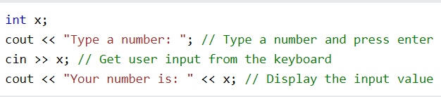
C++ User Input
cin is a predefined variable that reads data from the keyboard.
Uses extraction operator (>>).

Slide 16
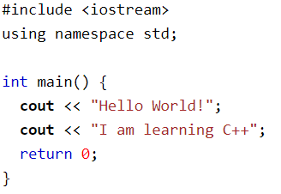
C++ Output (Print Text)
The cout object, together with the << operator, is used to output values/print text.

Slide 17
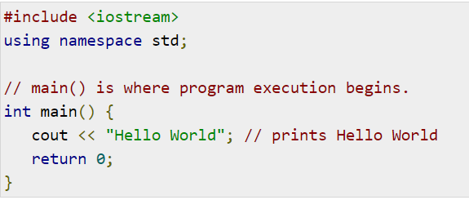
C++ Program Structure
Let us look at a simple code that would print the words Hello World.

Slide 18
Breakdown
The C++ language defines several headers, which contain information that is either necessary or useful to your program. For this program, the header <iostream> is needed.
The line using namespace std; tells the compiler to use the std namespace. Namespaces are a relatively recent addition to C++.
The next line '// main() is where program execution begins.' is a single-line comment available in C++. Single-line comments begin with // and stop at the end of the line.

Slide 19
Breakdown
The line int main() is the main function where program execution begins.
The next line cout << "Hello World"; causes the message "Hello World" to be displayed on the screen.
The next line return 0; terminates main( )function and causes it to return the value 0 to the calling process.

Slide 20
Basic Data Types
int : (4 bytes) - Stores whole numbers, without decimals.
float : (4 bytes) - Stores fractional numbers, containing one or more decimals. Sufficient for storing 7 decimal digits.
double : (8 bytes) - Stores fractional numbers, containing one or more decimals. Sufficient for storing 15 decimal digits.
boolean : (1 byte) - Stores true or false values

Slide 21
Assignment 2
Explain the general structure of C++ program.
Write a program to ask a age from the program and display it on the screen.

Slide 22
return 0

